Slide 1
DOCKER NETWORKING
Ritik Pansuriya(181IT237)
Shidharth S(181IT243)
Karthik R(181IT235)

Slide 2
INTRODUCTION
Docker is an open source platform that run applications and makes the process easier to develop, distribute.
The applications that are built in the docker are packaged with all the supporting dependencies into a standard form called a container.
These containers keep running in an isolated way on top of the operating system’s kernel.
Docker is designed is to give a quick and a lightweight environment where code can be run efficiently.

Slide 3
Literature Survey
link=”http://paper.ijcsns.org/07_book/201703/20170327.pdf”
The above shown paper is named as 'An Introduction to Docker and Analysis of its Performance' written by Babak Bashari Rad, Harrison John Bhatti, Mohammad Ahmadi.
The paper explains about formation of docker container, how images are stored in it, importance of docker in comparision of virtual machine and performance analysis.
Advantages of docker is speed, portability, scalability, Rapid delivery, Density.
Disadvantages are Incomplete virtualization, need 64 bit system, security issues, etc.

Slide 4
Objectives
To show networking in docker.
Configure Docker to use a proxy server.
Show working of DNS in docker.
Port forwarding in docker.

Slide 5
Requirements Analysis
Hardware Requirements
4GB RAM
BIOS-level hardware virtualization support must be enabled in the BIOS settings.
Software Requirements
64bit processor
Docker has to be installed

Slide 6
Work Plan
Learning phase
Making docker containers
Introducing networking in docker
Implementation of Proxy servers,DNS and Port forwarding

Slide 7
Bridge network
Container1 container2 container3

Slide 8
Overlay Network
Network1 Network2 Network3 Network4
-- Docker containers

Slide 9
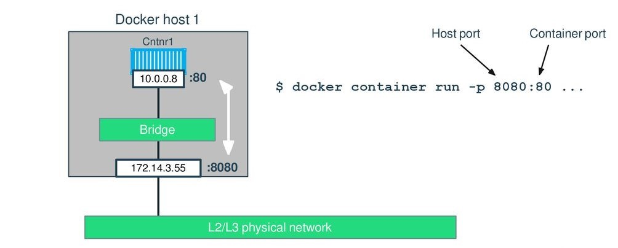

Slide 10
Docker Networking Commands
docker container run <image_name> - creates and runs a docker container from the given image
docker container ls -lists all the running container
docker network create <type> <network_name> - creates a network with specified name and type
docker network ls - lists all networks
docker kill <process_name> - kill the mentioned process
docker container rm <container_id> - container of given id is removed(deleted)
docker container port <container_id> - gives port information about the given container
docker network inspect <network_name> - gives details about the network mentioned

Slide 11
Conclusion
We expect to have a basic understanding of docker networking.
We expect to have control over which port selected on our docker container.

Slide 12
Individual Contribution
Ritik Pansuriya(181IT237):Proxy Server Implementation and basic networking
Shidharth S(181IT243):Overlay Networking and basic networking
Karthik R(181IT235):DNS Implementation and Port forwarding

Slide 13


